Slide 1
Computer Modeling and Simulation
Lecture 30

Slide 2
Inventory Model - An Example
Stock products which sell for 𝑟 = 100 each
Customer inter-arrival time 𝑑~exponential 𝜆 = 5
Each customer demands products (can only sell stock) 𝐷~uniform(1,4)
Order policy: when inventory is 𝑥 < 𝑄, place an order for 𝑦 = 𝑆 − 𝑥 (only one outstanding order at a time)
Cost = 50 ⋅ 𝑦 to order 𝑦 units
Delay of 𝐿 = 2 days until delivery
Holding cost of ℎ = 2 per item per day

Slide 3
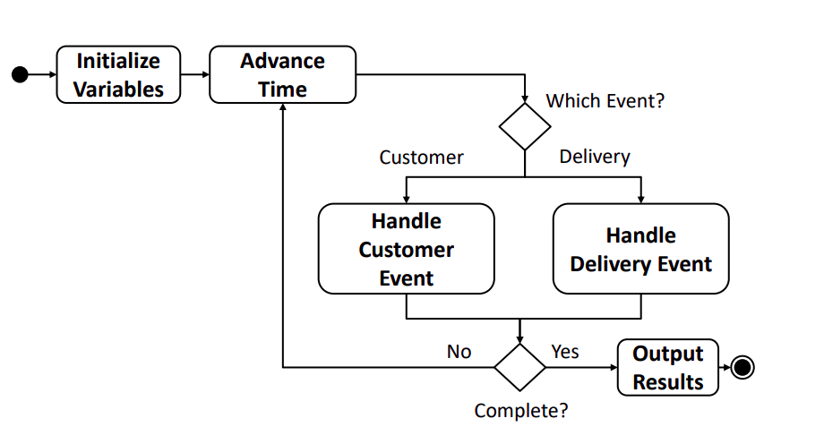
Activity Diagram

Slide 4

Advance Time

Slide 5
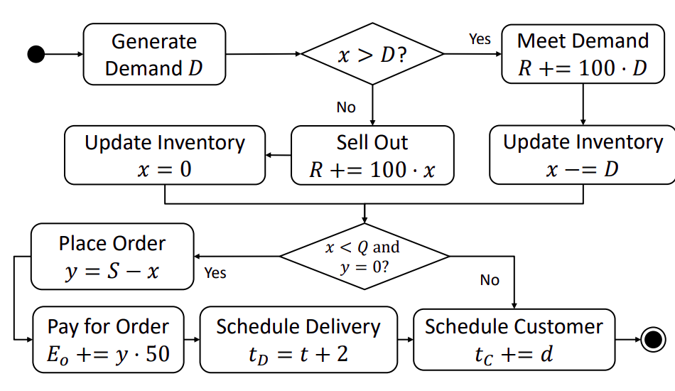
Customer Event

Slide 6
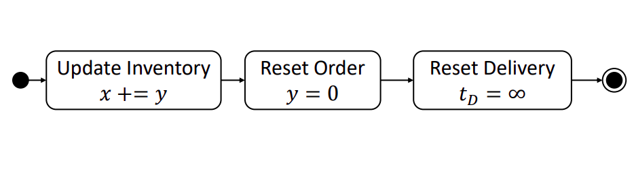
Delivery Event

Slide 7
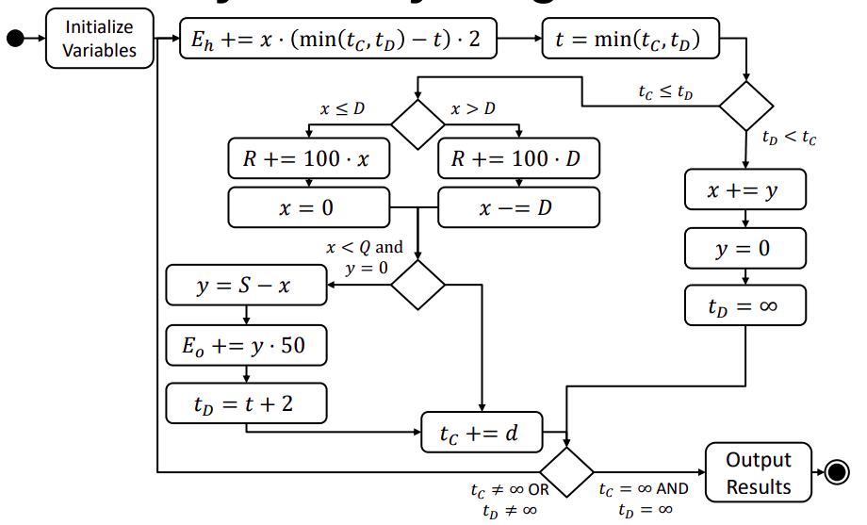
Complete Activity Diagram

Slide 8
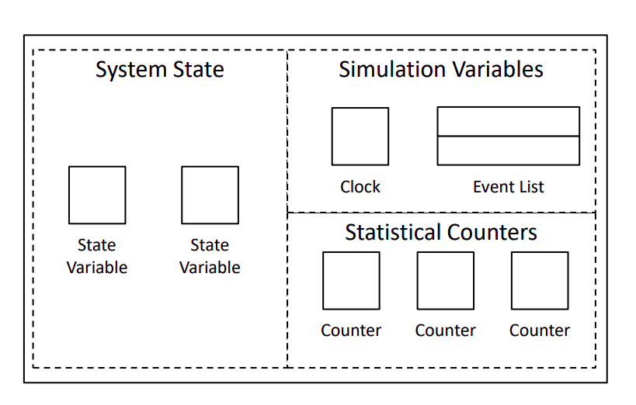
Inventory Model Structure

Slide 9
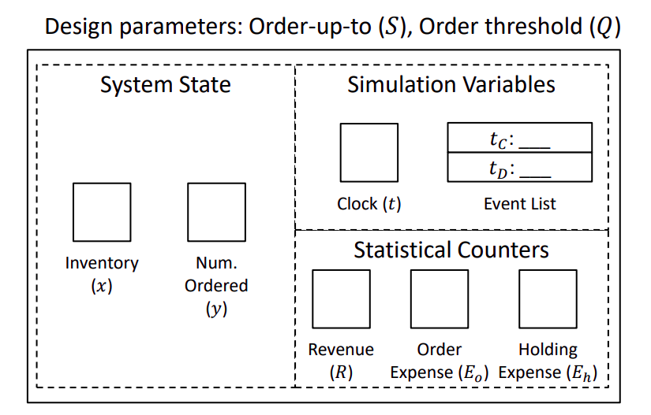
Inventory Model Structure

Slide 10
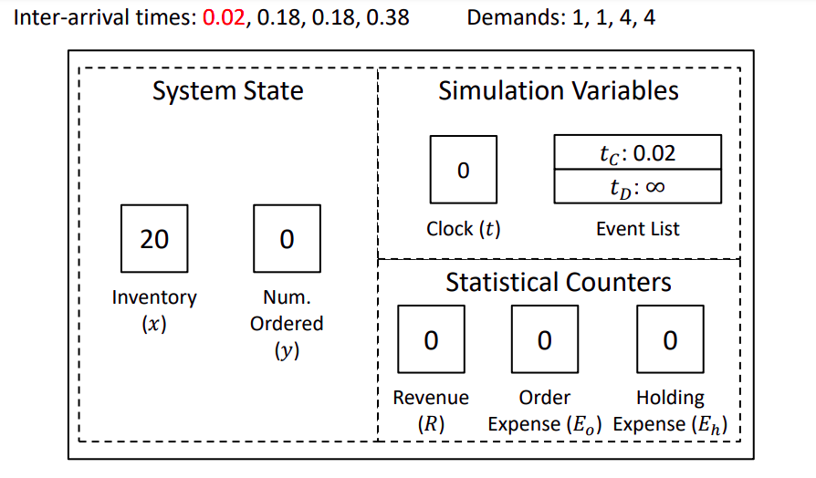
Initialize Simulation

Slide 11
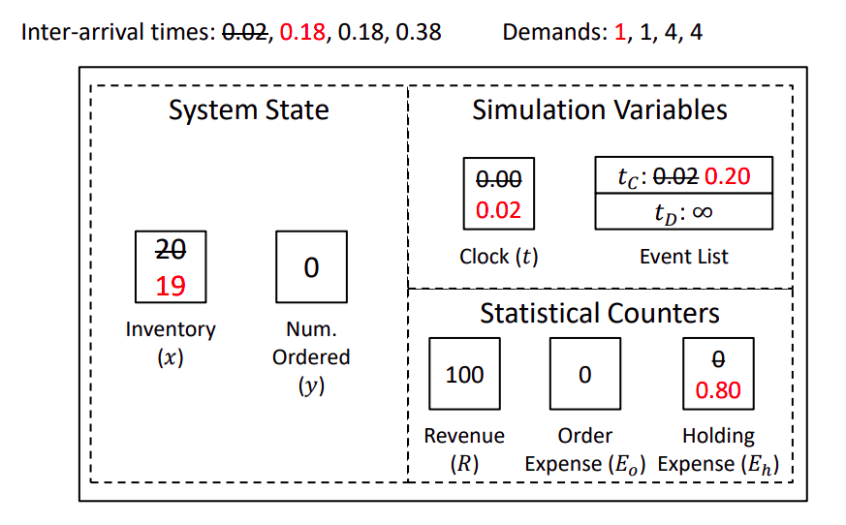
Customer @ 𝒕 = 𝟎. 𝟎2

Slide 12
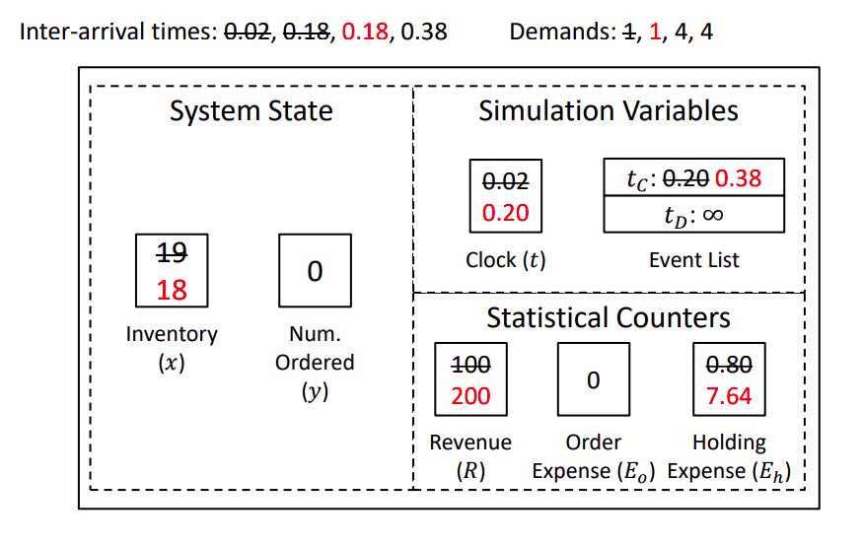
Customer @ 𝒕 = 𝟎. 20

Slide 13
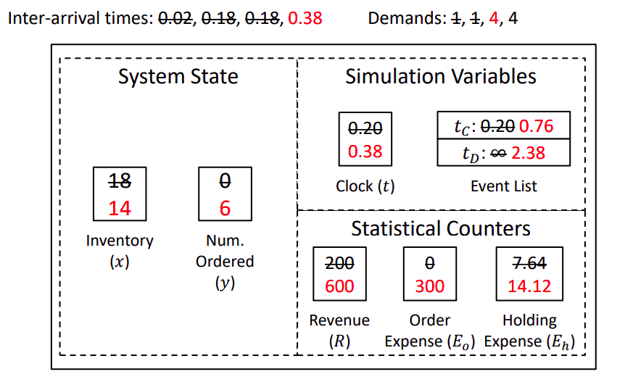
Customer @ 𝒕 = 𝟎. 38

Slide 14
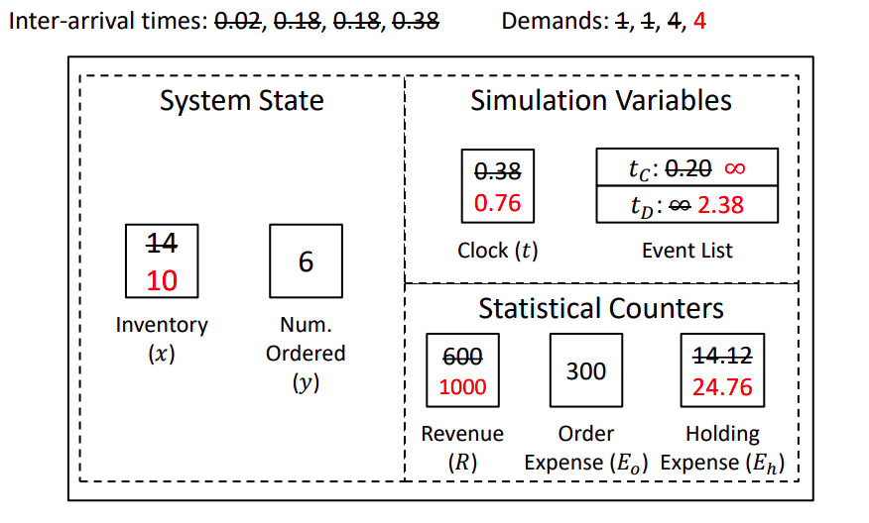
Customer at t=0.76

Slide 15
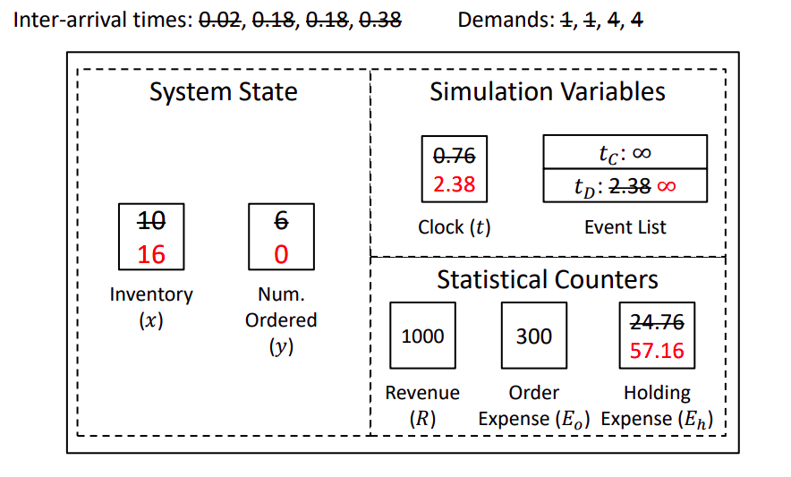
Delivery at t=2.38

